Slide 1
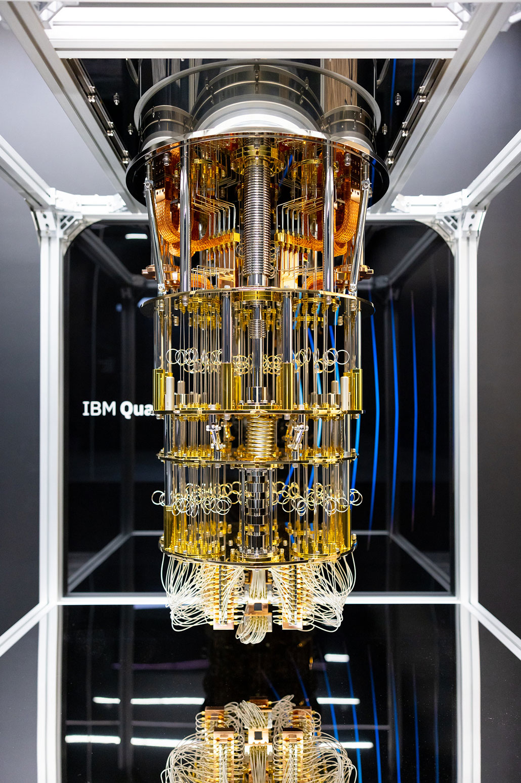
Quantum computing

Slide 2
introdution
Quantum Computing : a new type of computing that uses the laws of quantum physics to process information in a completely different way from classical computers.

Slide 3
Classical vs quantum

Slide 4
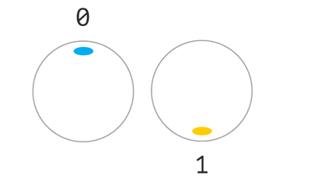
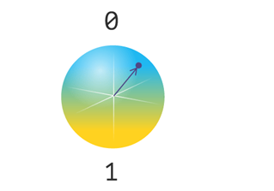
classical
quantum
Information is encoded using classical bits where they can be either 0 or 1 only
The computing power comes from how many transistors are in a processing unit which basically represent bits.
Information is encoded using quantum bits where they can be either 0 or 1 or both at the same time thru a concept called superposition.
The computing power comes from how many qubits are in a processing unit.

Slide 5
superposition
Mathematically, superposition is a linear combination of "0" and "1" and can be written as:
∣ψ⟩ = α∣0⟩ + β∣1⟩
∣0⟩ represents the 0 state. ∣1⟩ represents the 1 state.
When we measure the qubit, it collapses to one of the two states:
Probability of reading out 0: ∣α∣^2
Probability of reading out 1: ∣β∣^2

Slide 6
entanglement

Slide 7
How quantum computers work

Slide 8
applications
Cryptography: Quantum computers can break certain classical encryption methods, such as RSA.
Medicine: Quantum computers can simulate molecules and chemical reactions with high accuracy.
Artificial Intelligence and Machine Learning: Quantum algorithms can accelerate computations used in AI and machine learning.
Optimization Problems: Many practical problems in finance, logistics, and traffic management require finding the best solution among many options.

Slide 9
Challenges
Qubit fragility & cryogenics — Qubits lose coherence easily, so systems need ultra-low temperatures and strong isolation.
Error correction — Quantum noise causes frequent errors; today’s error-correction methods are heavy on resources and not yet practical at scale.
Cost & technical complexity — Cryogenics, precision control electronics, and specialized facilities make machines expensive and hard to build/maintain.
Scalability — Moving from tens to thousands or millions of high-fidelity qubits requires breakthroughs in fabrication, interconnects, cooling, and architecture.

Slide 10
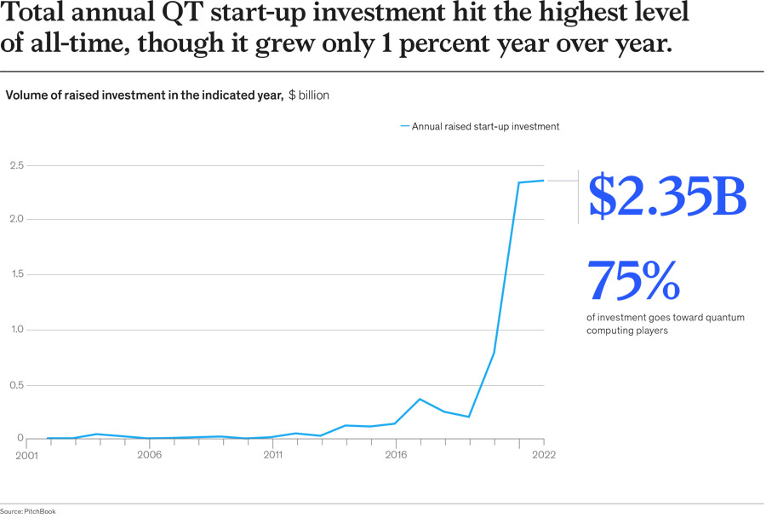
Future outlook

Slide 11


Companies

Slide 12
Thank You

